Slide 1
Biomass Cookstove Optimization Tool
Liam Cassidy
Spring 2019

Slide 2
Overview
Project Motivation
Background
Research Gap
Theory
Software Details
Preliminary Results
Conclusions
Future Work
Questions

Slide 3
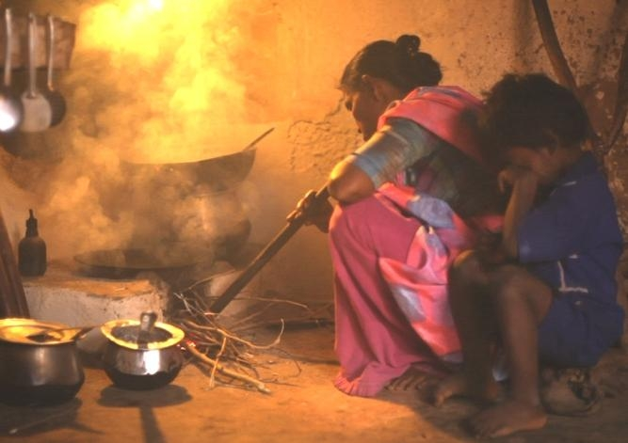
Project Motivation—Global Significance
Population Significance: In 2010, over 2.4 billion rely on biomass to fuel household cooking and heating¹.
Health Significance: Nearly 4 million premature deaths annually due to poor combustion quality¹.
Environmental Significance: Black Carbon, CH₄, CO and CO₂ emissions contribute to climate change².
Indoor Air Pollution²
[1] MacCarty, N., Bryden, K., Modeling of household Biomass cookstoves: A review. June 2015
[2] Clean Cooking Alliance, Climate and Environment, 2018.

Slide 4
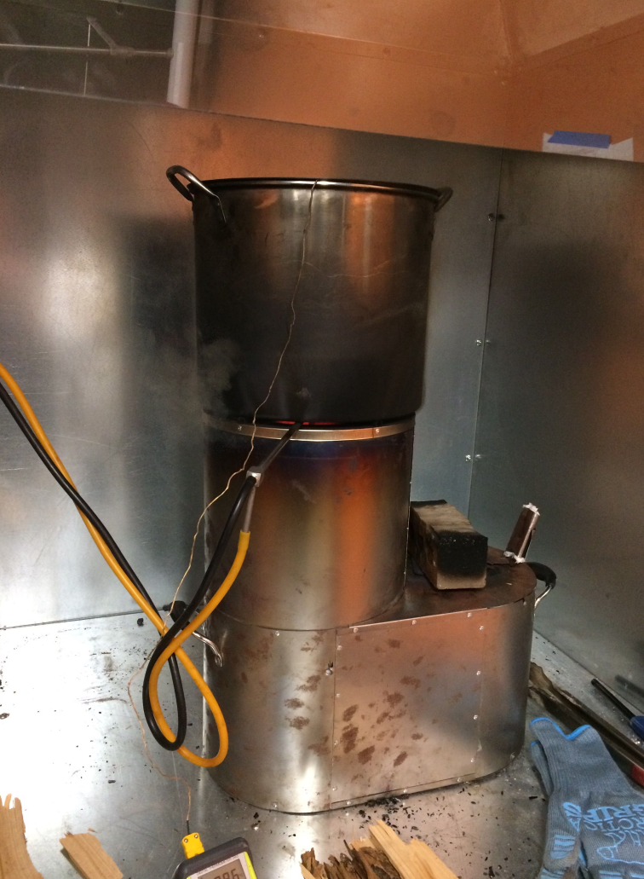
Project Motivation—Cookstove Industry
Current Goals: Design affordable clean burning cookstoves
Current Methods: Experimental—Trial and error
Problems: time consuming, expensive, low impact.
Solution: Computational modelling
Instrumented Cookstove³
[3] Erin Pfieffer, Oregon State University, 2018

Slide 5
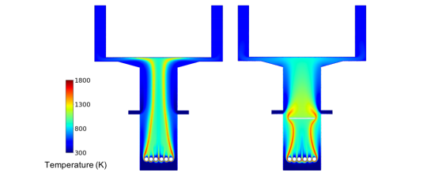
Background
Existing CFD modelling:
Posner et al. Steady State, 2D, forced draft CFD model of single cookstove geometry⁴.
Limited impact
Miller-Loinberg fine resolution transient, 3D, natural draft CFD model of single cookstove geometry⁵.
Inaccessible
Out of Context Contour Plots⁴
[4] Posner, Jonathon D., Multidisciplinary Design of an Innovative Natural Draft, Forced Diffusion Cookstove for Woody and Herbaceous Biomass Fuels in East Africa., University of Washington, September 2018.
[5] Miller-Loinberg, D., A Fine Resolution CFD Simulation Approach for Biomass Cook Stove Development., Colorado State University, Spring 2011.

Slide 6

Research Gap
No existing open-source modelling software for cookstove designers.
Current investigations are limited to single cookstove geometries.
Proposed Solution: Develop user-friendly software for cookstove CFD simulation with optimization functionality. Allow users to analyze any geometry based on a variety of input parameters.
Software Development

Slide 7
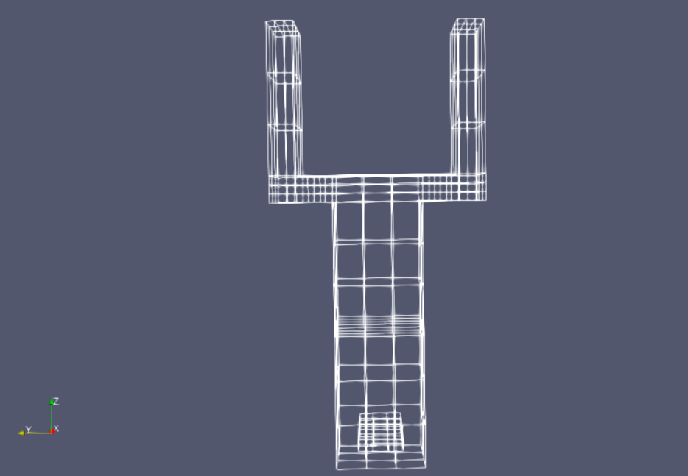


Theory—CFD Models
2-dimensional domain:
Transient simulation:
$∆t={10}^{−5} s$
Reaction Model:
Adapted from reactingFoam solver

Slide 8
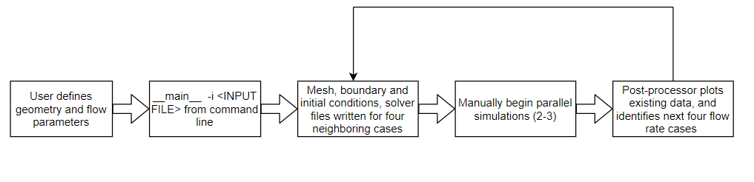
Software—Overview
Windows OS, programmed in Python using Spyder IDE.
Dependencies:
Python (V 2.7 or greater), OpenFOAM (V6), Linux subsystem
General Flow:

Slide 9
Software—User Inputs
w_{ch}
Geometric Parameters:
Combustion chamber diameter (d_{c})
Combustion chamber height (h_{c})
Height of secondary inlet (h_{FD})
Diameter of secondary inlet (d_{FD})
Channel width (w_{ch})
Channel height (h_{ch})
Cone deck length (L_{cd})
Pot spacing (p_{sp})
Flow Parameters:
Secondary inlet flow rate (U_{FD})
Cook pot
h_{ch}
p_{sp}
L_{cd}
U_{FD}
d_{FD}
h_{c}
h_{FD}
d_{c}

Slide 10
Software—Modules
Import_geometry:
Extracts geometry from user definition, converts to strings compatible with OpenFOAM convention
create_blockmeshfile:
Writes the geometry and mesh assignment to blockMeshDict file
setup_surrounding_cases:
Creates four new cases (varying flow rate) around the user defined flow rate (25-150% user defined flow rate). Writes initial conditions, solver, and control files for each
runner:
Automate meshing and simulations in parallel.
*Still in development*
post_processor:
Reads data from OpenFOAM output files
Computes maximum average pot temperature at final time step as metric for optimization
Plots existing case file results
Creates four new cases surrounding the optimal case from the previous five simulations

Slide 11
Software—Optimization Details
Single variable optimization.
Design variable: Secondary air flow rate
Objective function: Average cookpot temperature at final time step
Direct method: only using objective function values to guide search
Closest neighboring algorithm called “exhaustive search method”
Break design space into equally spaced discrete inputs

Slide 12
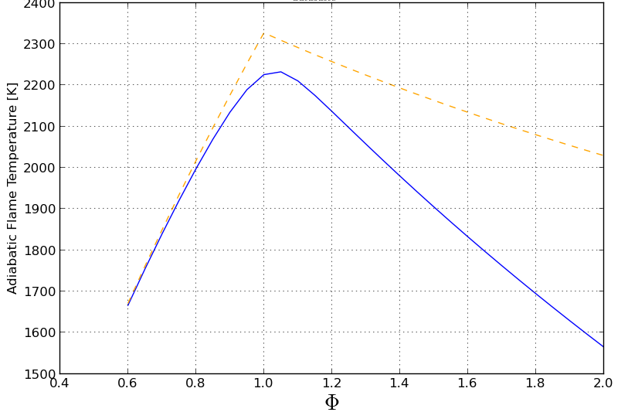
Software—Optimization Approach
Example: Adiabatic flame temperature Methane-Air versus Equivalence ratio.
Expected similar qualitative behavior for cookpot temperature versus secondary flow rate.
Adiabatic Flame Temp CH4-Air vs Equivalence Ratio [7]
[6] Cantera User’s Guide, Methane-Air Combustion. 2017.

Slide 13
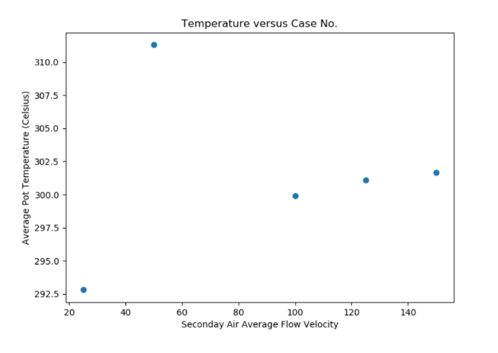
Software—Preliminary Results
Maximum average pot temperature
Investigate
Investigate
Software Results Initial Sweep
Adiabatic Flame Temp CH4-Air vs Equivalence Ratio: Expected Behavior

Slide 14
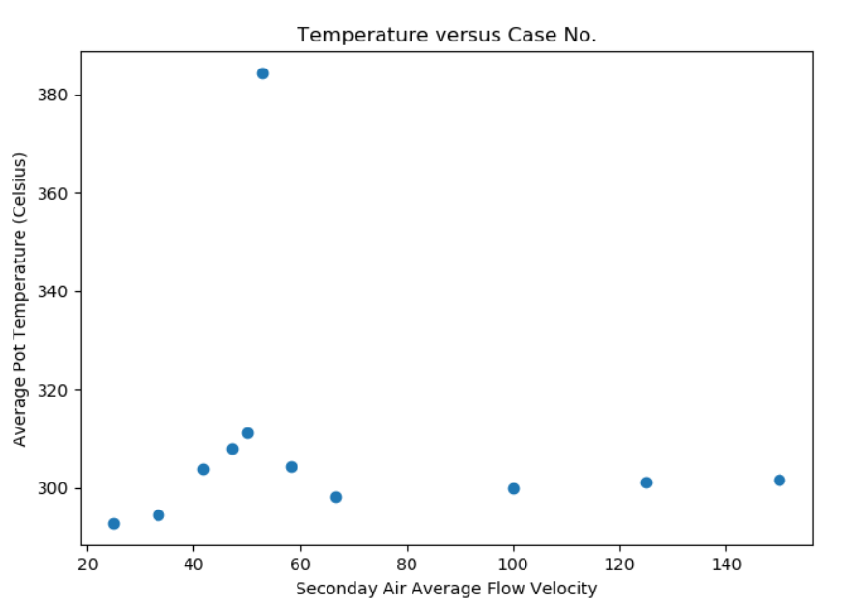
Software—Preliminary Results
Previous max
Updated max
Results—After One Optimization Iteration

Slide 15
Conclusions
Reasonable results qualitatively
Sufficient for relatively predictable design space
Firewood combustion complexities not captured
Time consuming

Slide 16
Future Work
Reduce Simulation Time:
Convert CFD to Axisymmetric
Automate parallel case runs
Improve Optimization Algorithm:
Multiple design variables
Gradient based methods
Alternative methods: Genetic Algorithm
Improve Physical Relevance:
Biomass combustion
SS simulation, or extended time frame

Slide 17

Questions

Slide 18
References
[1] MacCarty, N., Bryden, K., Modeling of household Biomass cookstoves: A review. June 2015
[2] Clean Cooking Alliance, Climate and Environment, 2018.
[3] Erin Pfieffer, Oregon State University, 2018
[4] Posner, Jonathon D., Multidisciplinary Design of an Innovative Natural Draft, Forced Diffusion Cookstove for Woody and Herbaceous Biomass Fuels in East Africa., University of Washington, September 2018.
[5] Miller-Loinberg, D., A Fine Resolution CFD Simulation Approach for Biomass Cook Stove Development., Colorado State University, Spring 2011.
[6] Cantera User’s Guide, Methane-Air Combustion. 2017.

